Slide 1
For the case of secaurity we would like to have access key rotation. We would like to change the AccessKeys after every 90 days and delete the old keys in the next 30 days of creation of the new key. The users which have already 2 access keys for valid reasons would remain in the exception list. Since we have not implemented this there would be keys which are more than 200 or even more days old. First we would load the script which would generate new accesskeys and send email to the users and in 30 days they would have to change their keys because on the 31 day we would delete the old key.( see Flowchart 1) To do this automatically we would then run the script which would check if key is 90 days old generate a new send and email and after 30 days of this email we would delete the old key. (see flowchart 2)

Slide 2
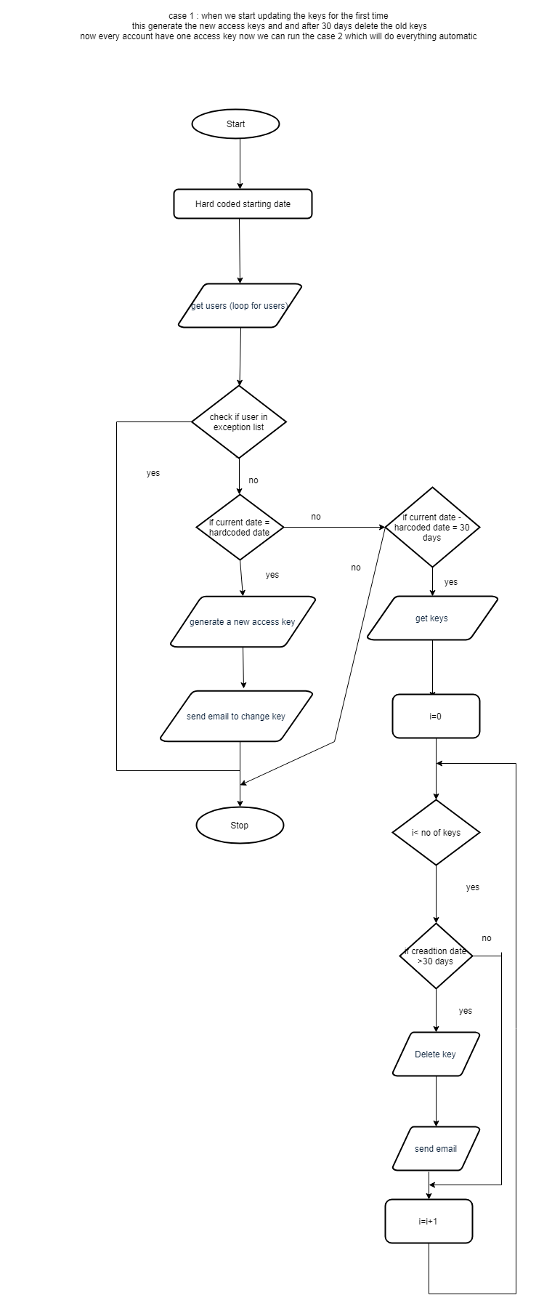
Flowchart 1

Slide 3
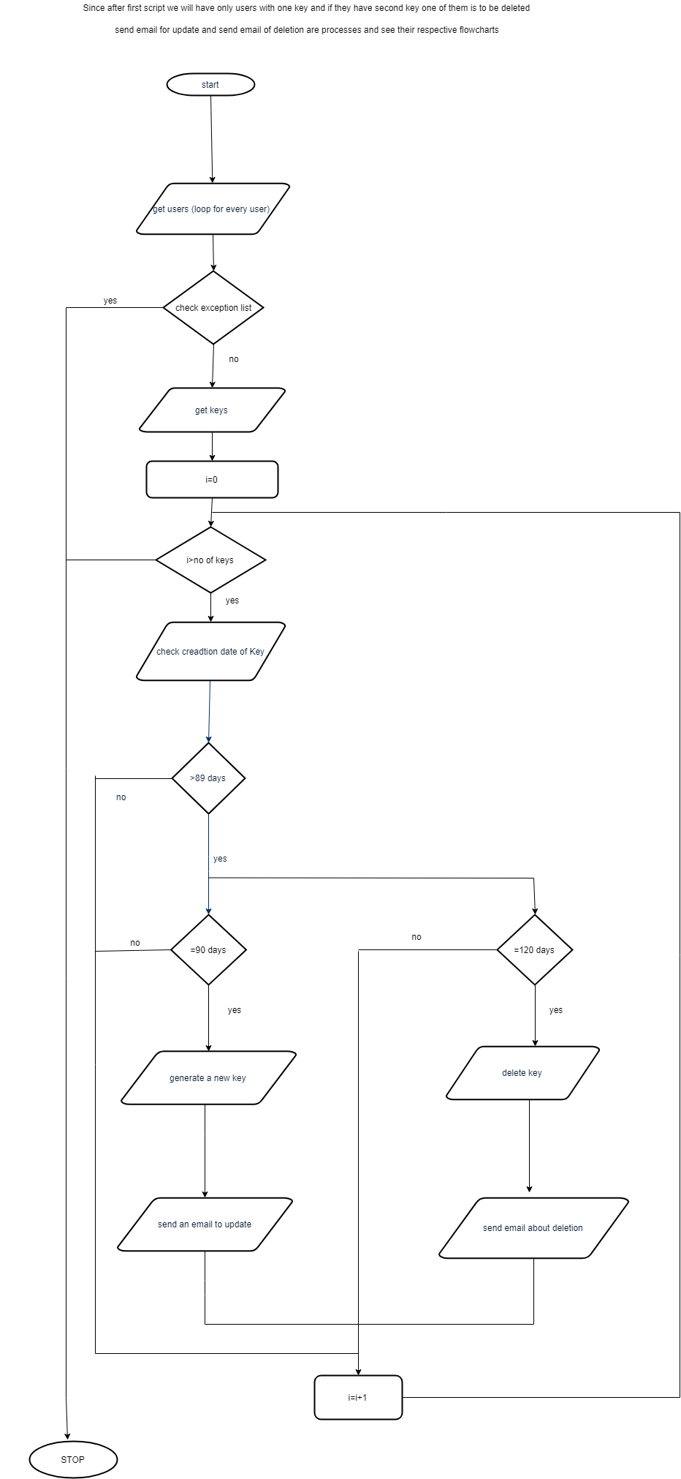
Flowchart 2

Slide 4
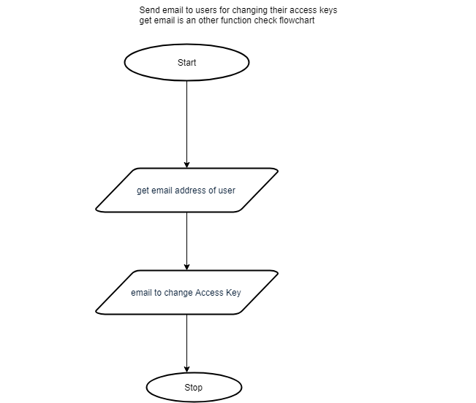
Send update email

Slide 5
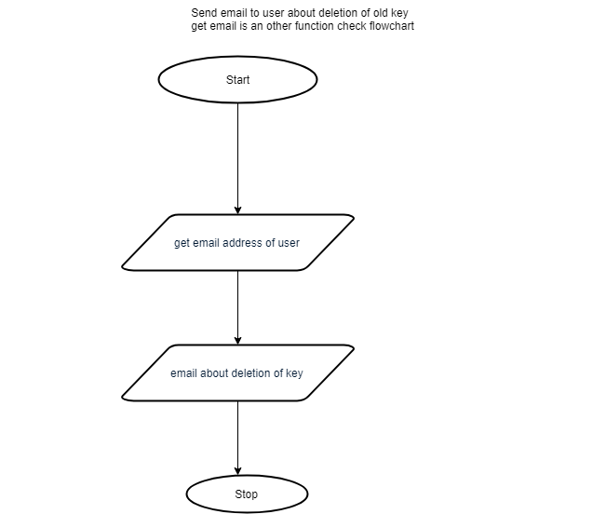
Deletion email

Slide 6
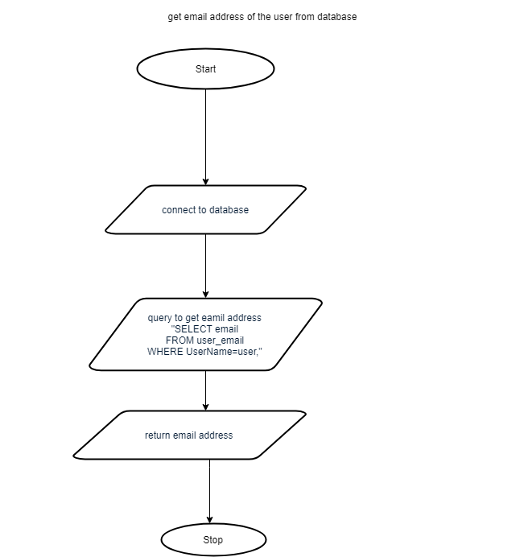
Get email address

